Slide 1
Spring Framework

Slide 2
Spring Basic IOC

Slide 3
Lesson Objectives
Introduction to Spring Framework
  Learn what is the Spring Framework, its benefits and architecture
  Learn about the IoC (Inversion of control) and how it allows wiring beans and scope of bean.
  Learns the types of bean factories and life-cycle of beans in these factories
  Understand applying Annotations to Spring applications
Notes:
Page 01-<number>
Spring Framework Spring basics and IoC
Explain the lesson coverage

Slide 4
Module contents - Spring basics and IoC
Introduction to Spring Framework
IOC – Inversion of control
Injecting dependencies through setter and constructor injections
Bean containers
Wiring Beans
Life cycle of Beans in the factory container
Annotation-based configuration
Notes:
Page 01-<number>
Spring Framework Spring basics and IoC
Additional notes for instructor

Slide 5
Introduction
It all started with a bean
December 1996 – JavaBeans makes its appearance
Sophisticated applications often require services not directly provided by the JavaBeans specification
Many successful applications built based on EJB
  But EJB never really achieved its intended purpose: to simplify enterprise application development
  EJB’s mandate deployment descriptors and plumbing code
Java development comes full circle
  New programming techniques like including aspect-oriented programming (AOP) and inversion of control (IoC) giving JavaBeans much of the power of EJB
Notes:
Page 01-<number>
Spring Framework Spring basics and IoC
It all started with a bean. In 1996, the Java programming language was still a young, exciting, up-and-coming platform. Many developers flocked to the language because they had seen how to create rich and dynamic web applications using applets. But they soon learned that there is more to this strange new language than juggling animated cartoon characters. Unlike any language before it, Java made it possible to write complex applications made up of discrete parts. They came for the applets, but stayed for the components.
It was in December of that year that Sun Microsystems published the Java-Beans 1.00-A specification. JavaBeans defined a software component model for Java. This specification defined a set of coding policies that enabled simple Java objects to be reusable and easily composed into more complex applications. Although JavaBeans were intended as a general-purpose means of defining reusable application components, they have been primarily used as a model for building user interface widgets. They seemed too simple to be capable of any “real” work. Enterprise developers wanted more.
Sophisticated applications often require services such as transaction support, security and distributed computing- services not directly provided by the JavaBeans specification. Therefore in March 1998, Sun published the 1.0 version of the Enterprise JavaBeans (EJB) specification. This specification extended the notion of Java components to the server side, providing the much-needed enterprise services, but failed to continue the simplicity of the original JavaBeans specification. In fact, except in name, EJB bears very little resemblance to the original Javabeans specification.

Slide 6
What is Spring?
Spring is an open source framework created by Rod Johnson, Juergen Hoeller et all
Addresses the complexity of enterprise application development
Any java application can benefit from Spring in terms of simplicity, testability and loose coupling
Spring is a lightweight inversion of control and aspect-oriented container framework
Notes:
Page 01-<number>
Spring Framework Spring basics and IoC
Spring makes it easy to use POJO’s (Plain Old Java Objects) to achieve things that were previously only possible with EJB’s. However, Spring’s usefulness isn’t restricted to server-side development. Any java application can benefit from Spring in terms of simplicity, testability and loose coupling.
Put simply, Spring is a lightweight inversion of control and aspect-oriented container framework. Breaking this description down makes the description simpler:
Lightweight: Spring is Lightweight in terms of both size and overhead. The entire Spring framework can be distributed in a single jar file of 2.5 MB approximately. Processing overhead required by Spring is negligible. Moreover, Spring is non-intrusive; objects in a Spring-enabled application typically have no dependencies on Spring-specific classes.
Inversion of control: Spring promotes loose coupling through a technique known as inversion of control (IoC) or also known popularly as Dependency Injection (DI). When IoC is applied, objects are passively given their dependencies instead of creating or looking for dependent objects for themselves. IoC can be thought of as JNDI in reverse – instead of an object looking up dependencies from a container, the container gives the dependencies to the object at instantiation without waiting to be asked.

Slide 7
What is Spring?
Lightweight: in terms of both size and overhead
Inversion of control: promotes loose coupling
Aspect-oriented : enables cohesive development by separating application business logic from system services
Container: contains and manages the life cycle and configuration of application objects
Framework: possible to configure and compose complex applications from simpler components
Notes:
Page 01-<number>
Spring Framework Spring basics and IoC
Aspect-oriented : Spring comes with rich support for aspect-oriented programming that enables cohesive development by separating application business logic from system services (such as auditing and transaction management). Application objects do what they are supposed to do – perform business logic – and nothing more. They are not responsible for other system concerns such as logging or transactional support.
Container: Spring is a container in the sense that it contains and manages the life cycle and configuration of application objects. You can configure how each of your beans should be created – either create one single instance of your bean or produce a new instance every time one is needed based on a configurable prototype – and how they should be associated with each other.
Framework: Spring makes it possible to configure and compose complex applications from simpler components. In Spring, application objects are composed declaratively, typically in an XML file. Spring also provides much infrastructure functionality (transaction management, persistence framework integration etc) leaving the development of application logic to user.
All these attributes of Spring enable you to write code that is cleaner, more manageable and easier to test.

Slide 8
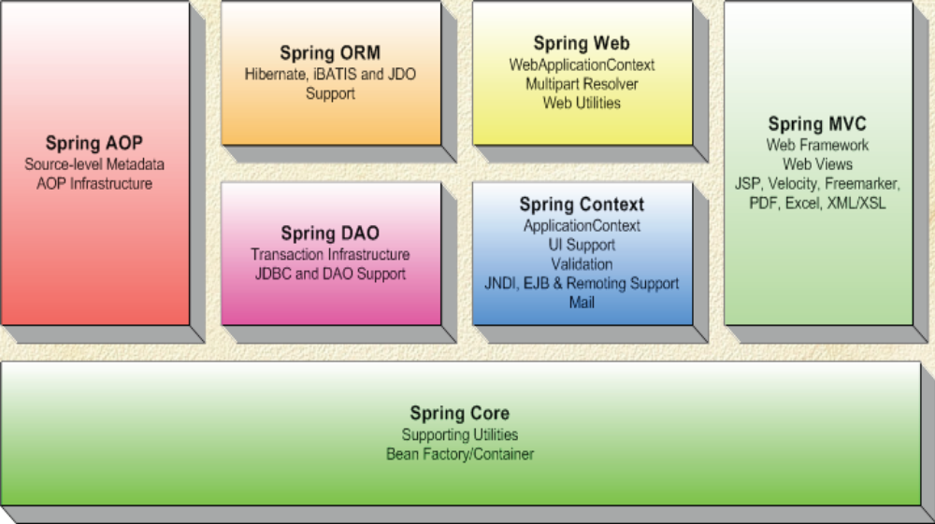
The Spring architecture
Notes:
Page 01-<number>
Spring Framework Spring basics and IoC
Spring could potentially be a one-stop-shop for all your enterprise applications. However, Spring is modular, allowing you to use parts of it, without having to bring in the rest. You can use the bean container, with Struts on top, but you could also choose to just use the Hibernate integration or the JDBC abstraction layer.
The Spring framework is a layered architecture consisting of several well-defined modules. The Spring modules are built on top of the core container, which defines how beans are created, configured, and managed, as shown in above figure. Each of the modules (or components) that comprise the Spring framework can stand on its own or be implemented jointly with one or more of the others. The functionality of each component is as follows:
The Core package : is the most fundamental part of the framework. It defines how beans are created, configured and managed. A primary component of the core container is the BeanFactory, an implementation of the Factory pattern. The BeanFactory applies the Inversion of Control (IOC) pattern to separate an application's configuration and dependency specification from the actual application code
The Context package is on top of the Core package. The core modules bean factory makes Spring a container, but the context modules makes it a framework. It extends the concept of a bean factory, adding support for internationalisation, application lifecycle events and validation.

Slide 9
IoC, beans and BeanFactories
Used to achieve loose coupling between several interacting components in an application.
The IoC framework separates facilities that your components are dependent upon and provides the “glue” for connecting the components.
BeanFactory : core of Spring’s DI container
In Spring, the term “bean” is used to refer to any component managed by the container
Notes:
Page 01-<number>
Spring Framework Spring basics and IoC
Loose coupling is one of the critical elements in object-oriented software development. It allows you to change the implementations of two related objects without affecting the other object. Strong coupling can make life more difficult when it comes to the scalability of an application. Thus, coupling is a two headed beast. On one hand, tightly coupled code is difficult to test, difficult to reuse, difficult to understand. On the other hand, completely uncoupled code doesn’t do anything. In order to do anything useful, classes need to know about each other somehow. Coupling is necessary but it must be managed very carefully. A common technique used to reduce coupling is to hide implementation details behind interfaces so that actual implementation class can be swapped out without impacting the client class.
That is what IoC is all about: the responsibility of coordinating collaboration between dependent objects is transferred away from the objects themselves. This is where lightweight framework containers like Spring come into play.
IoC introduces the concept of a framework of components that in turn has many similarites to a J2EE container. The IoC framework seperates facilities that your components are dependent upon and provides the “glue” for connecting the components.
With Inversion of Control (IoC) you can achieve loose coupling between several interacting components in an application.
The core of Spring’s DI container is the BeanFactory. A bean factory is responsible for managing components and their dependencies. We shall see bean factories in detail later in this session. In Spring, the term “bean” is used to refer to any component managed by the container. Typically, beans adhere to Javabeans specification

Slide 10
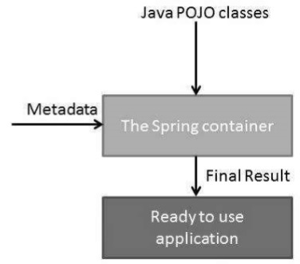
Ioc Container
The IoC container is responsible to instantiate, configure and assemble the objects. The IoC container gets informations from the XML file and works accordingly. The main tasks performed by IoC container are:
  to instantiate the application class
  to configure the object
  to assemble the dependencies between the objects

Slide 11
Spring has two types of containers:
  Bean factories : are the simplest, providing basic support for dependency injection
  Application contexts : build on bean factory by providing application framework services
Following are the three important methods to provide configuration metadata to the Spring Container −
  XML based configuration file.
  Annotation-based configuration
  Java-based configuration

Slide 12
Dependency Injection
Dependency Injection
Dependency Injection (DI) is a design pattern that removes the dependency from the programming code so that it can be easy to manage and test the application. Dependency Injection makes our programming code loosely coupled.
Ways to perform Dependency Injection in Spring framework
  By Constructor
  By Setter method
  By Interface
Here we are going to inject
  primitive and String-based values
  Dependent object (contained object)
  Collection values etc.

Slide 13
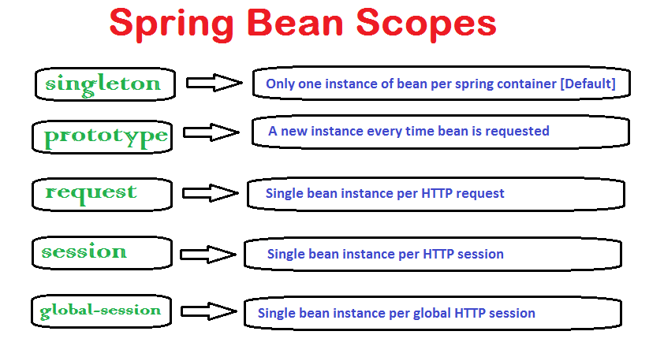
Spring Bean Scopes

Slide 14
Autowiring
Autowiring lets Spring wire all bean’s properties automatically by setting the autowire property on each <bean> that you want autowired
  <bean id=”foo” class=”com.ABC.Foo” autowire=”autowire type” />
Four types of autowiring:
  byName
  byType
  constructor
  Autodetect
Notes:
Page 01-<number>
Spring Framework Spring basics and IoC
So far, you have seen how to wire all your bean’s properties explicitly. You can also have Spring wire them automatically by setting the autowire property on each bean that you want autowired.
There are four types of autowiring:
byName: Attempts to find a bean in the container whose name (or id) is same as the name of the property being wired. If matching bean not found, property will remain unwired.
byType: Attempts to find a single bean in the container whose type is same as the name of the property being wired.
constructor : tries to match up one or more beans in the container with the parameters of one of the constructors of the bean being wired. In the event of ambigous beans or ambigous constructors, an org.Springframework.beans.factory.UnsatisfiedDependencyException will be thrown.
autodetect : attempts to autowire by constructor first and then using byType.

Slide 15
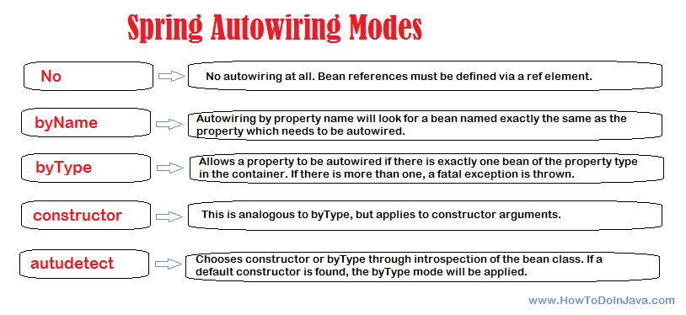

Slide 16
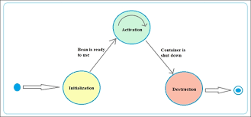
Spring Bean Life Cycle
When container starts – a Spring bean needs to be instantiated, based on Java or XML bean definition
It may also be required to perform some post-initialization steps to get it into a usable state.
After that, when the bean is no longer required, it will be removed from the IoC container.
Spring bean factory is responsible for managing the life cycle of beans created through spring container.

Slide 17
Spring framework provides following 4 ways for controlling life cycle events of a bean:
  InitializingBean and DisposableBean callback interfaces
  *Aware interfaces for specific behavior
  Custom init() and destroy() methods in bean configuration file
  @PostConstruct and @PreDestroy annotations

Slide 19
Annotation in Spring

Slide 20
@Component Indicates that an annotated class is a “component” and will be auto-detected when using annotation-based configuration and classpath scanning.
@Bean A method-level annotation used to declare a spring bean. When configuration execute annotated method, it registers the return value as a bean within a BeanFactory.
By default, the bean name will be the same as the method name. To customize the bean name, use its ‘name’ or ‘value’ attribute.
@Repository An specialization of the @Component annotation. In addition to importing the annotated DAO classes into the DI container, it also makes the unchecked exceptions (thrown from DAO methods) eligible for translation into Spring DataAccessException.
@Service An specialization of the @Component annotation. It indicates that a class is a “Business Service Facade” or something similar.
@Controller An specialization of the @Component to annotate controllers (e.g. a web controller). It used in combination with annotated handler methods based on the RequestMapping annotation.
@Qualifier During autowiring, if more than one bean of the same type is available in the container then container will throw runtime exception. To fix this problem, we have to specifically tell spring that which bean has to be injected using this annotation.
@Autowired Marks a constructor, field, setter method, or config method as to be autowired by dependency injection
@Required Default bean autowiring checks only that dependency has been set. It does not checks whether the assigned value is null or not.

Slide 21
@Value Applicable at the field or method/constructor parameter level, and indicates a default value expression for the affected argument.
@Lazy Indicates whether a bean is to be lazily initialized. By default, in spring DI, eager initialization will occur.
@Scope Indicates the name of a scope to use for instances of the annotated type. In Spring 5, beans can be in one of six scopes i.e. singleton, prototype, request, session, application and websocket.
@Configuration Indicates that a class declares one or more @Bean methods and can be processe
@ComponentScan along with @Configuration is used to enable and configure component scanning. By default, if we do not specify the path, it scans the current package and all of its sub-packages for components.d by the container to generate bean definitions when used along with @ComponentScan.

